Slide 1




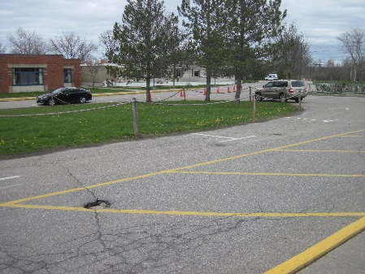
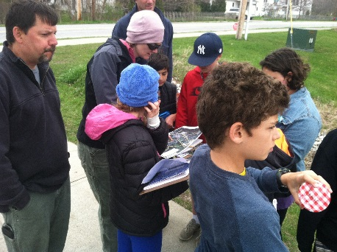
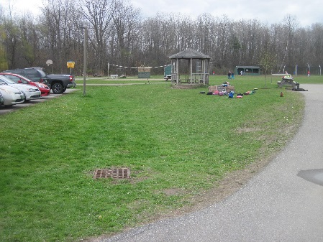
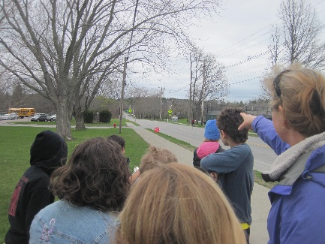
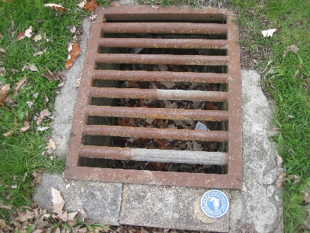
Ahead of the Storm
Education and Outreach
Site Evaluation Process
Presented By: Jessica Louisos, MS, PE
Funded by the Lake Champlain Basin Program - L-2019-032 EO AOTS Project

Slide 2




Overview
Learn about:
  Engineering Method
  Developing Stormwater Treatment
  Site assessment technique
  Basemapping
  Data Collection
Complete:
  Site assessment
  Identify problem areas
  Design concept level Optimal Conservation Practices

Slide 3

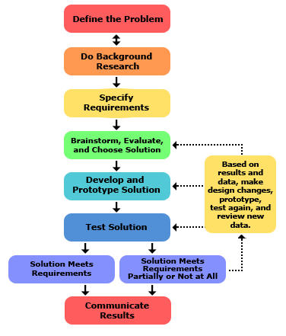
The Engineering Method
Steps engineers follow to solve a problem
Iterative
Image from teachengineering.org
Notes:
The specific terms used to describe the engineering method may vary, but the concepts are the same.

Slide 4
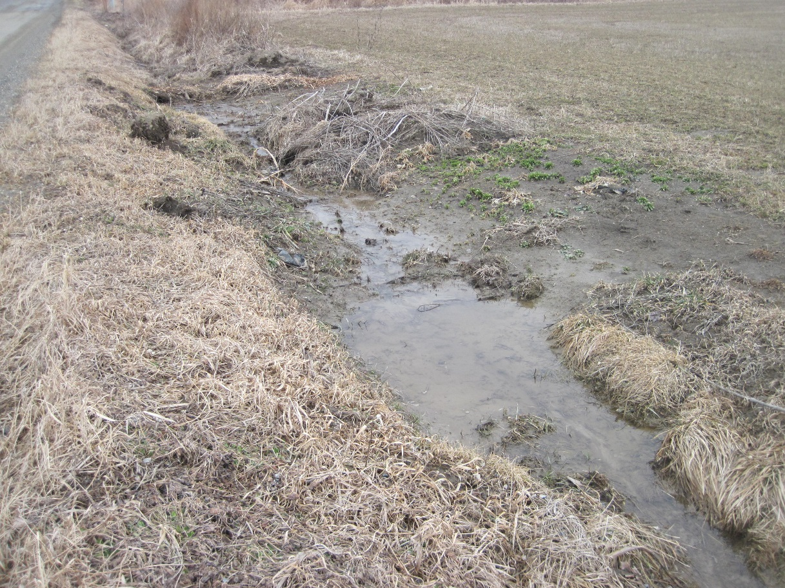
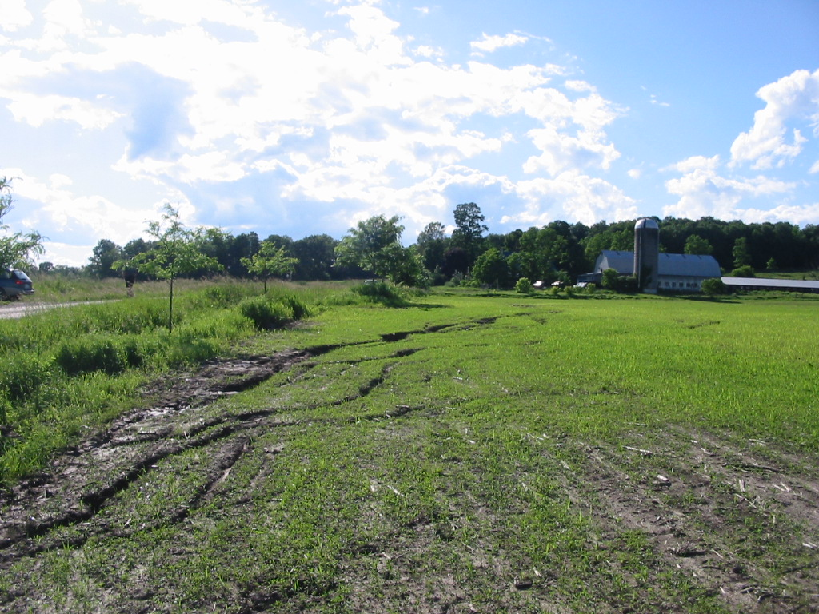
Identify Problem – Ask
Notes:
Define what the problem is. Ask questions. Specify goals for what you will solve.
We may be looking for where dirty water collects or where erosion is occurring.
This may apply to any type of problem. Maybe there is flood issue. Maybe a road that always has traffic jams.

Slide 5
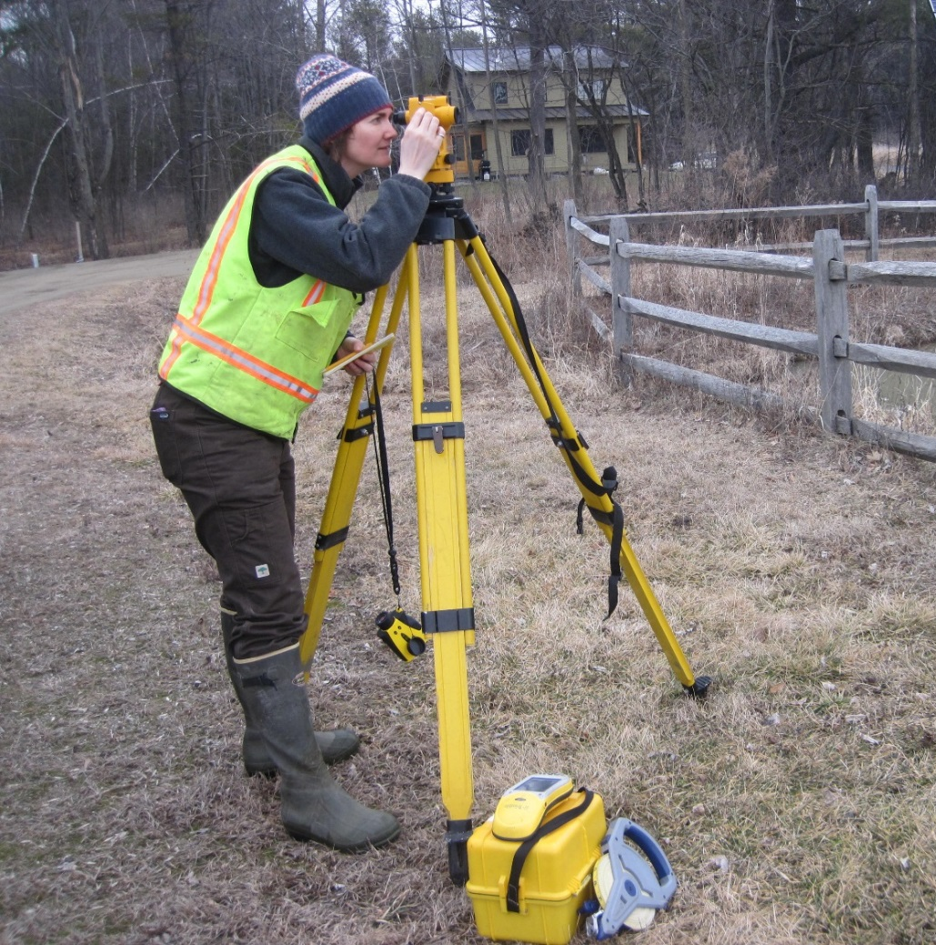
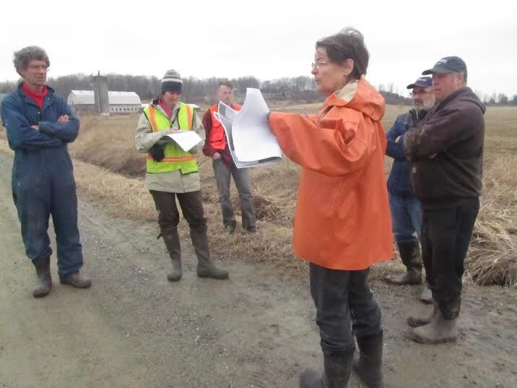
Data Collection – Research
Notes:
Collect information that will help solve a problem.
How much water gets to a location.
Are there sensitive natural resources or utilities that need to be avoided.
What are the elevations, slopes, or other data we need.

Slide 6
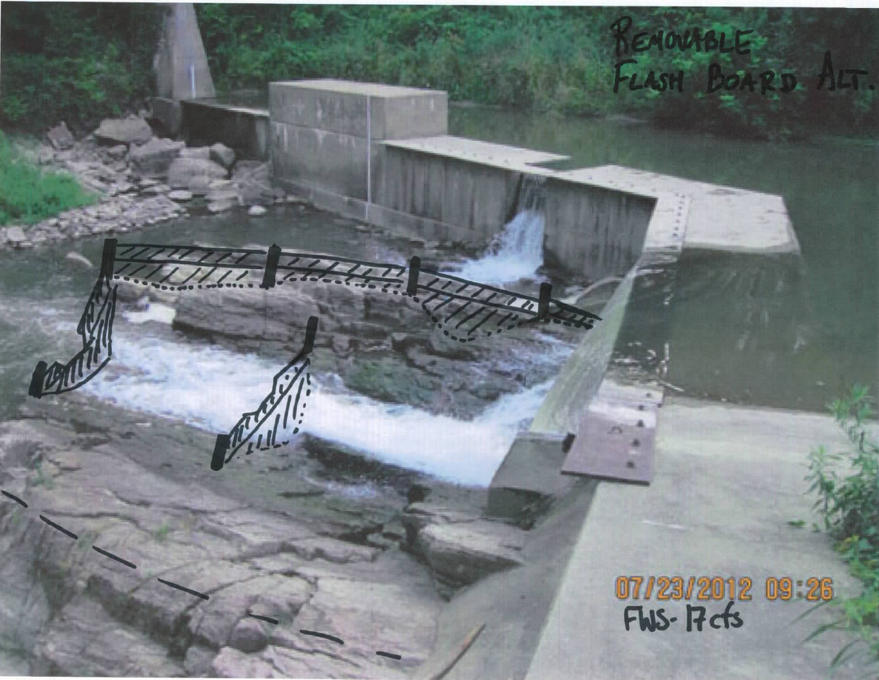
Alternatives Analysis – Imagine and Plan
Notes:
What could be possible solutions?
For each solution how well does it meet our goals?
Goals could be the level of treatment, the reduction in flooding, and factor in cost or other constraints.
Choose a solution that seems to best meet project goals.

Slide 7
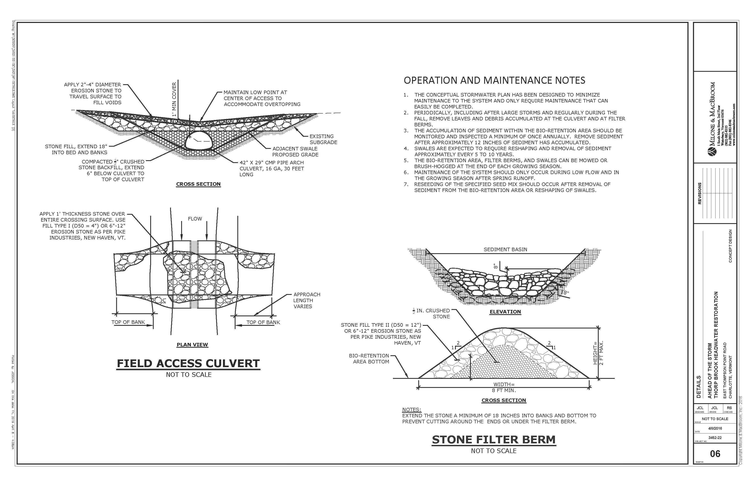

Design - Create / Test / Improve
Notes:
Develop plans that show location, size, materials needed.
Show views from above, cross sections, profiles, and images that give specific details.
Test if the design meets the goals and constraints
Improve if needed – maybe even going back to earlier stages for more data collection or alternatives

Slide 8
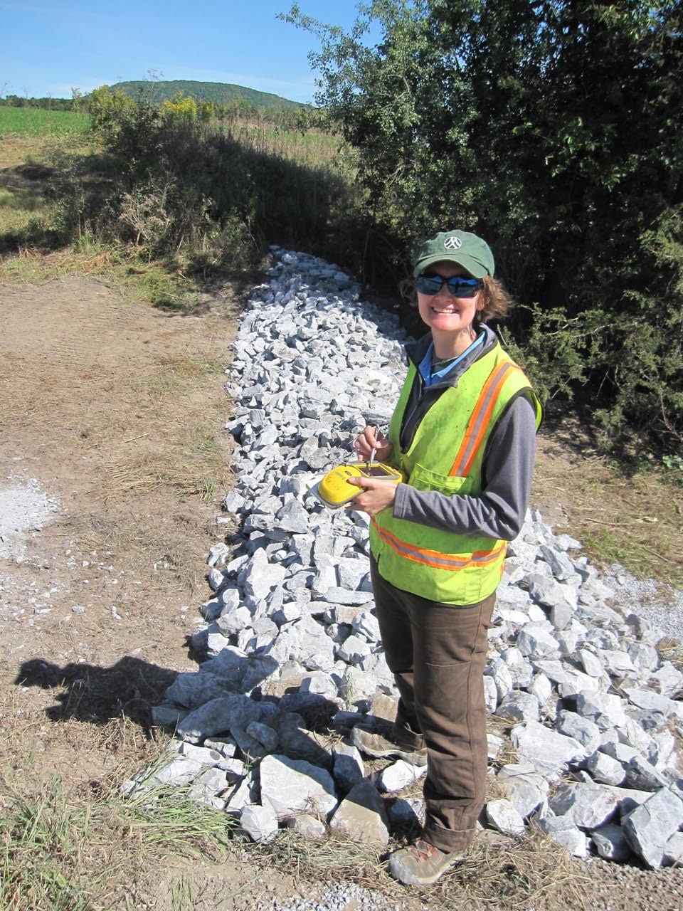
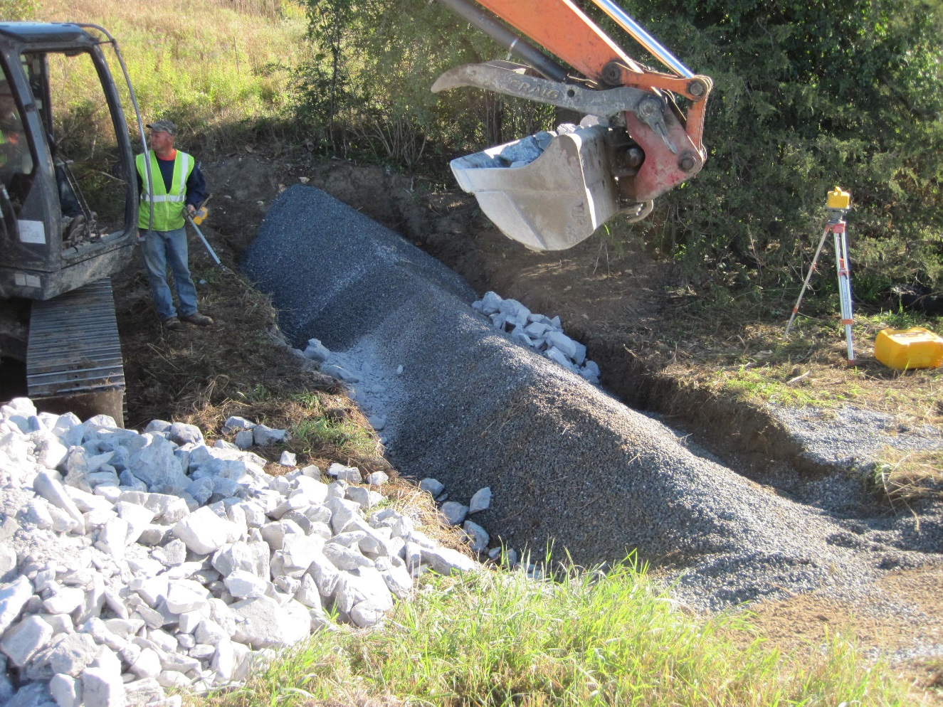
Implementation - Construction
Notes:
Exciting!
See the final product- your fix- put into action.
As engineers we usually oversee construction to make sure our designs are built correctly.

Slide 9
Design Process
See Handout
Notes:
Review all the steps
ask students how they might be able to do different parts
Identify which sections engineers may need to do for more complicated projects.

Slide 10
Mapping with ANR Atlas
Floodplains, River Corridor, Wetlands:
http://anrmaps.vermont.gov/websites/anra/
Precipitation:
http://precip.eas.cornell.edu/
Show some examples of basemaps and how to get them
Notes:
Go to ANR Atlas and click through some of the base map information

Slide 11
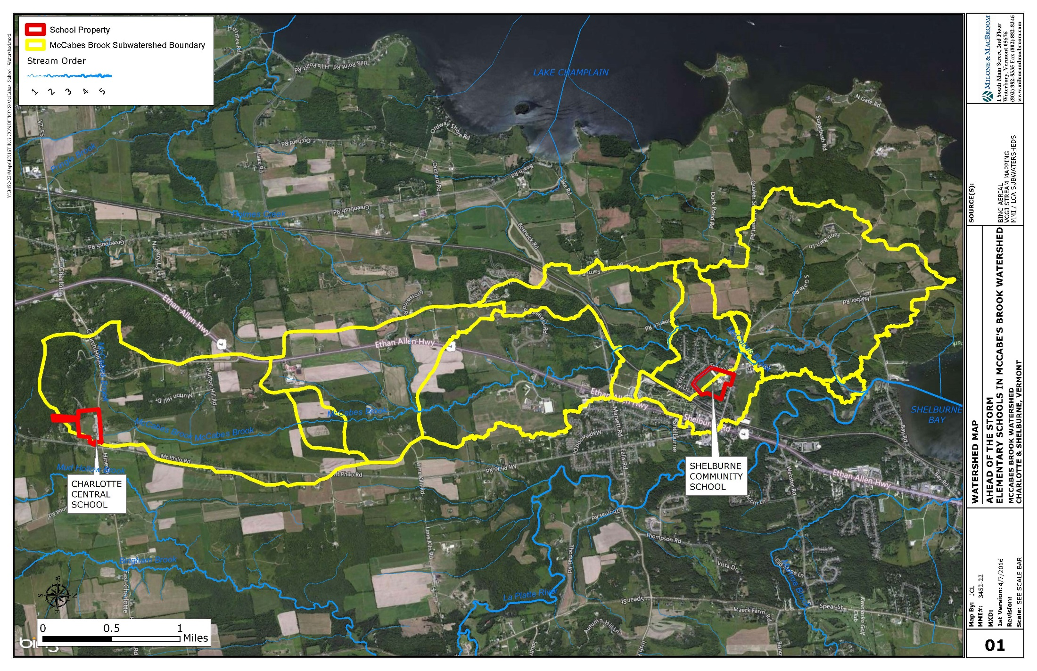
Ahead of the Storm – McCabe’s Brook Watershed

Slide 12
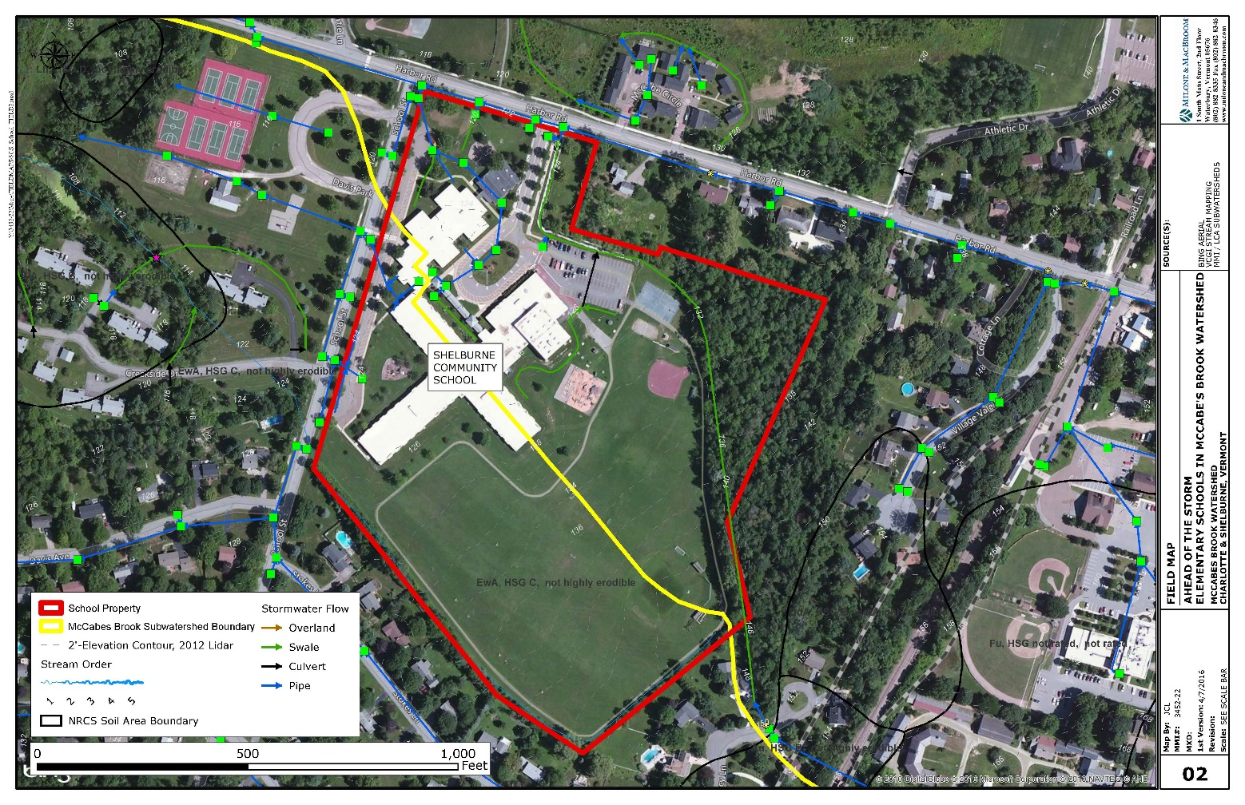
Site Assessment – Desktop Work - Homework
Aerial Photograph
Topography
Soils
Wetlands
Property Lines
  River Corridor
Fluvial Erosion Hazard Zone
FEMA Floodplains, Floodway
Stormwater Permit?

Slide 13
Map Exercise
Scale
Basemapping
Orientation
Notes:
Using pre-made map of their school have students identify how to read the map
Have them find landmarks they recognize
Turn map to match the orientation of the classroom
Discuss scale, how much smaller the map is from real life

Slide 14
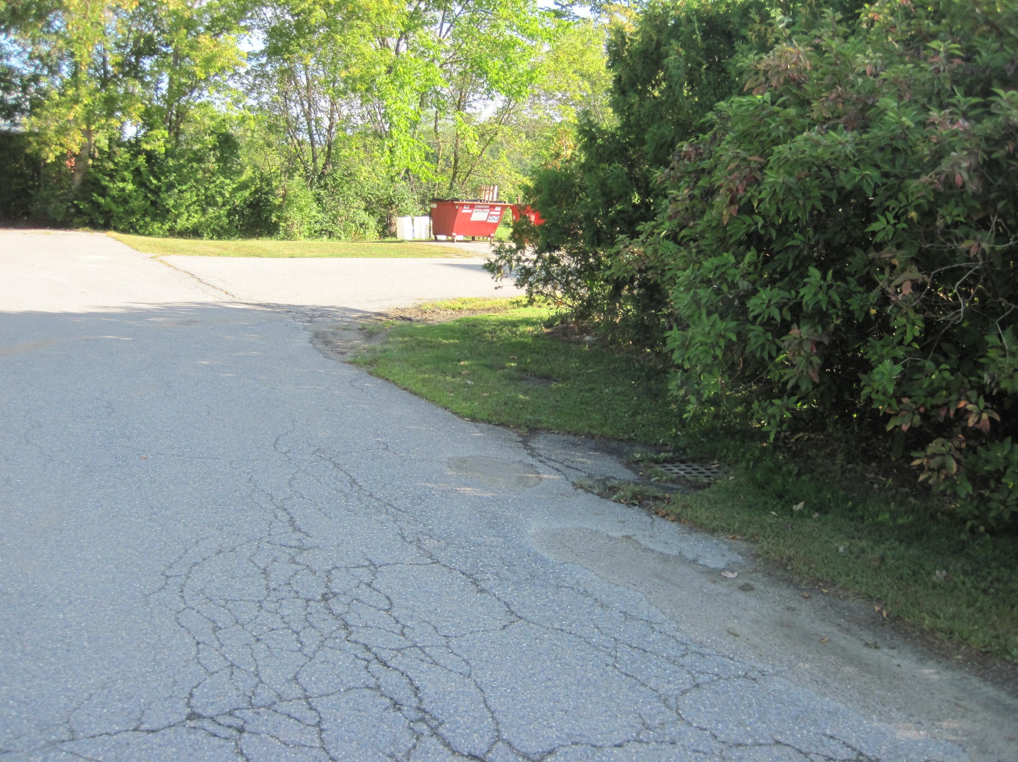
Problem Identification – Point Source

Slide 15
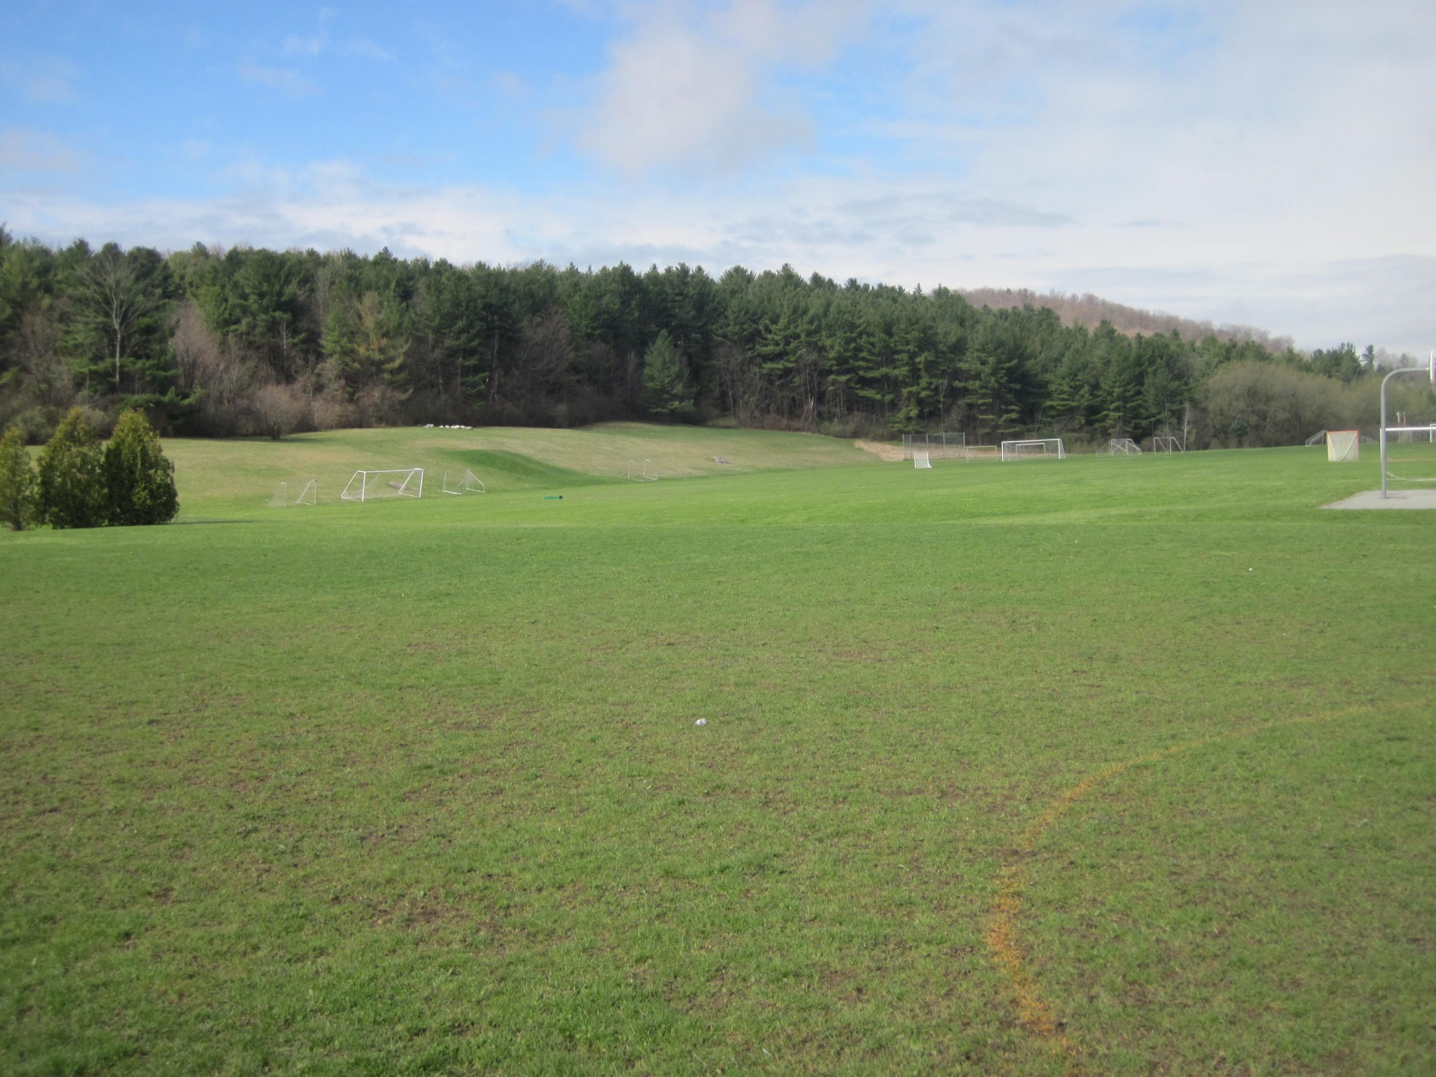
Problem Identification – Non-Point Source

Slide 16
Site Assessment – Fieldwork
Review handout
Notes:
Go back to handout – tell them that the Pre-Project Development and Desktop work have been done and they will be starting with a map
Go through Site Assessment Field work – what they will be looking for and drawing on the maps
Go out and do at least a portion of the site assessment
This could be helpful to have a grounds person at the school join in, but not necessary

Slide 17
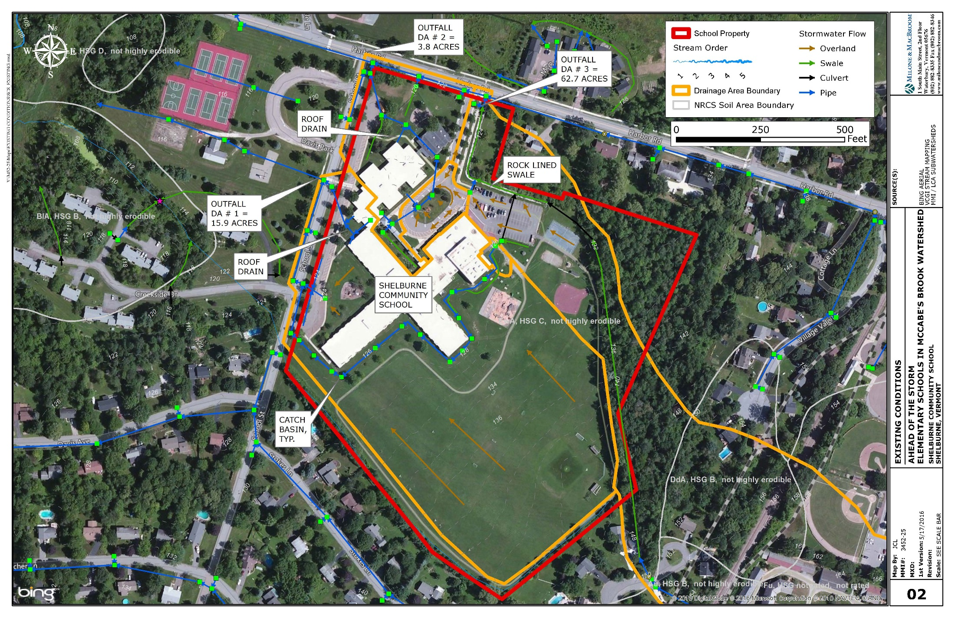
Site Assessment - Example
Notes:
This is an example of a completed assessment.

Slide 18
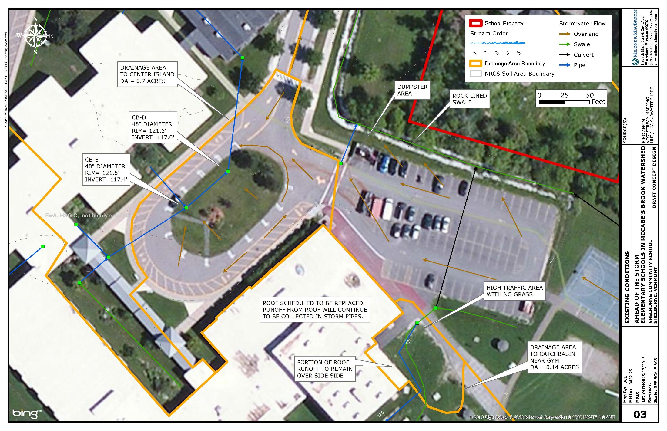
Site Assessment - Example
Notes:
Zoomed in completed assessment

Slide 19
Ahead of the Storm - Optimal Conservation Practices
The 3 S’s….
SLOW IT DOWN
SPREAD IT OUT
SOAK IT IN
Notes:
Our goal is to identify locations where water is collected and concentrated or where dirty water is running off impervious surface.
Once identified we will want to consider ways to Slow, Spread, and Soak. Next time we get together we will review specific ways to do that.
For now, just consider if there is space available where the problem exists to try to fix it at that location.

Slide 20
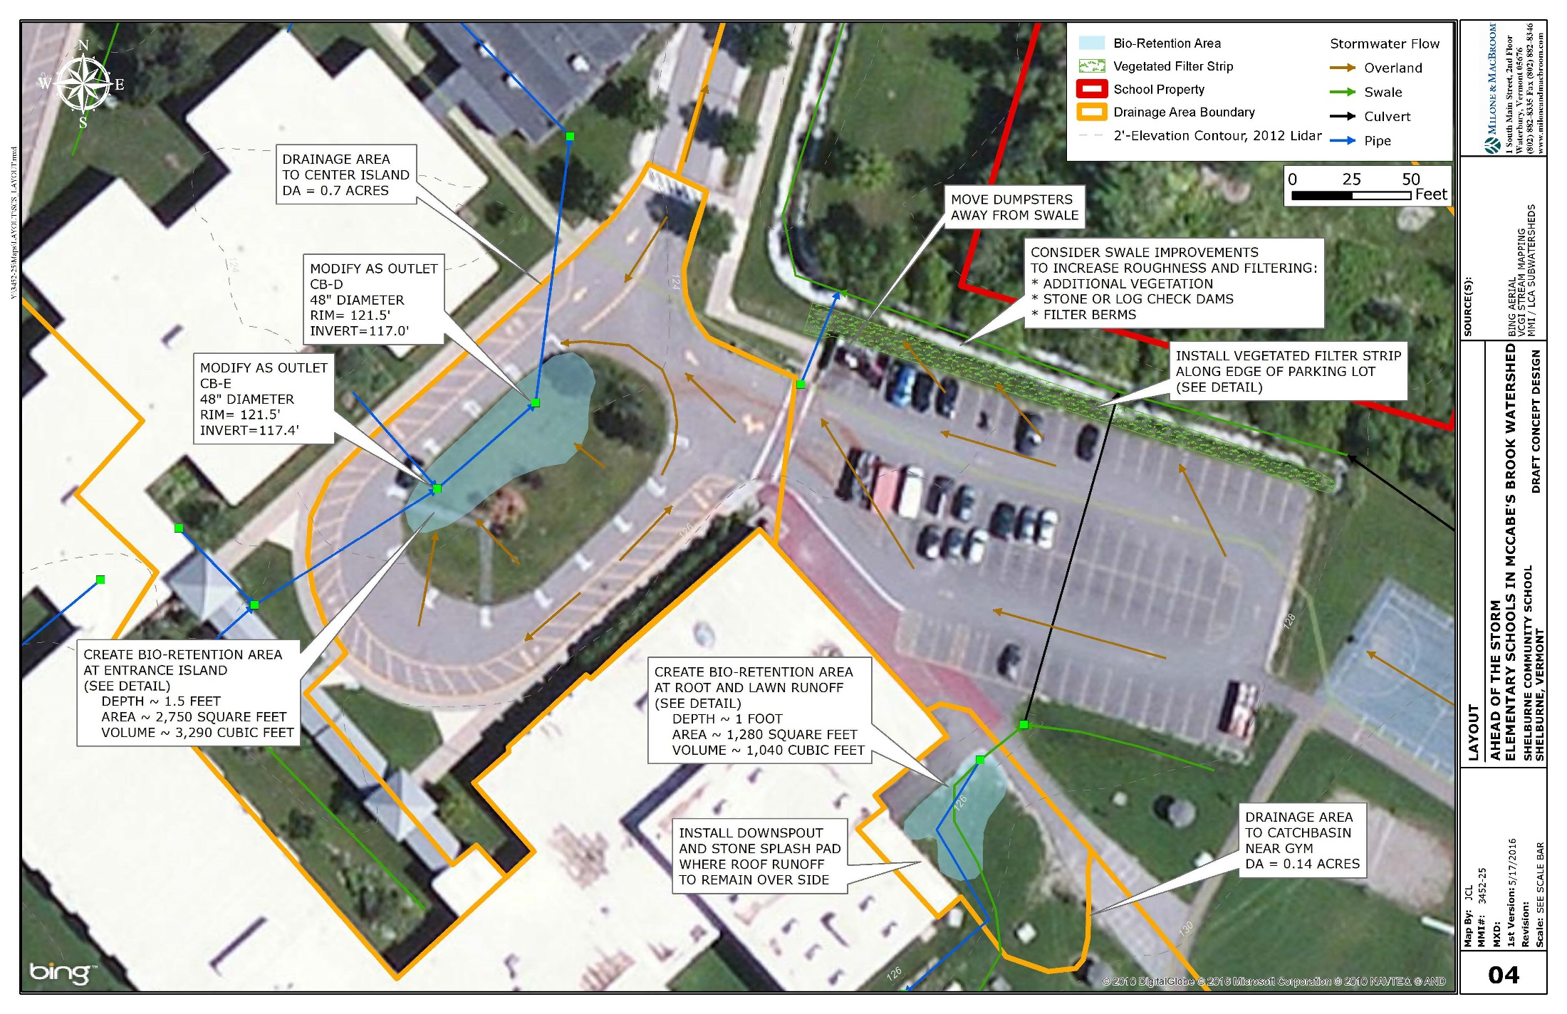
Design Plans - Layout
Notes:
This is an example of a design plan that shows treatment areas. This will be something we work towards during our next working session.
I wanted you to see it so you can visualize why we are doing the mapping now.

Slide 21
Site Assessment Activity – Today’s Goals
Orientation to maps
Begin mapping flow paths
Identify problem areas
Start to identify the subwatersheds
  Point Source
  Non-Point Source
Review Site Assessment Goals in Field
Answer questions
Notes:
Maps prepared ahead by engineers/teachers so there is something to use in the field for mapping these items.

Slide 22
Homework – Before next visit together
Finish site assessment
  Flow path lines
  Erosion areas
  Existing stormwater infrastructure
  Notes on impervious and landuse
  Think about constraints
Identify problem areas to discuss next time
Review Optimal Conservation Practices Design Principles Handout
Notes:
For older students, there is likely not enough time together for students to fully complete the site assessment. If this is the case, then they will have some homework.
For elementary age this can be adjusted to a shorter site assessment all together.
This ties in the handout given in the AOTS background session.

Slide 23
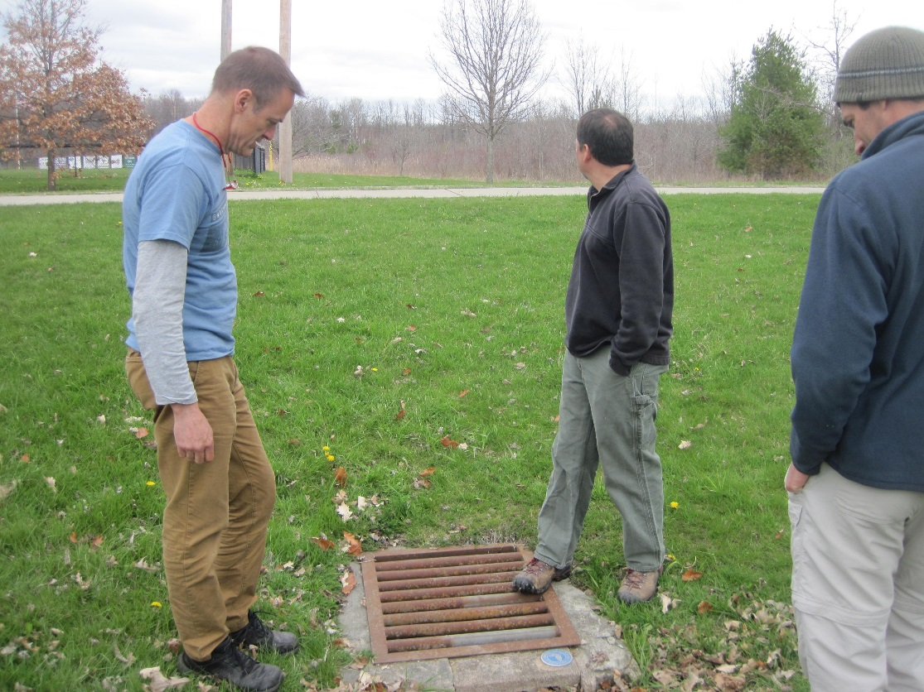
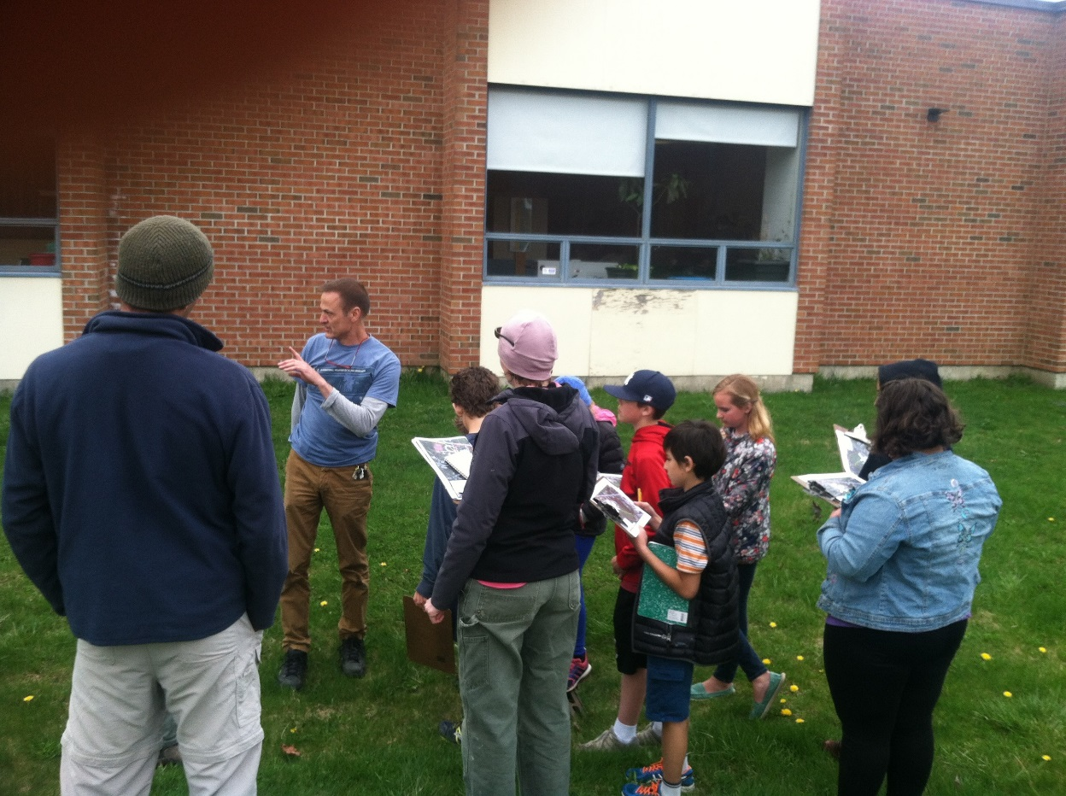
Site Assessment – Learn from Landowner

Slide 24
Site Assessment – Request Additional Data
General Permit No. 3-9010

Slide 25
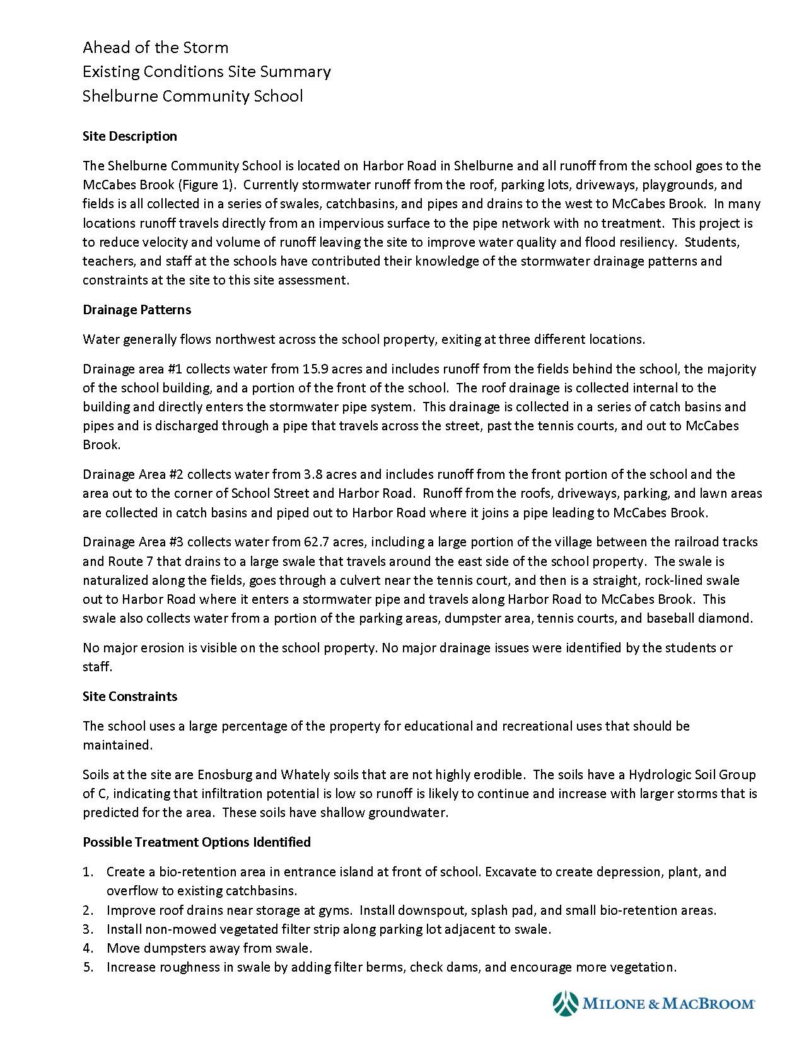
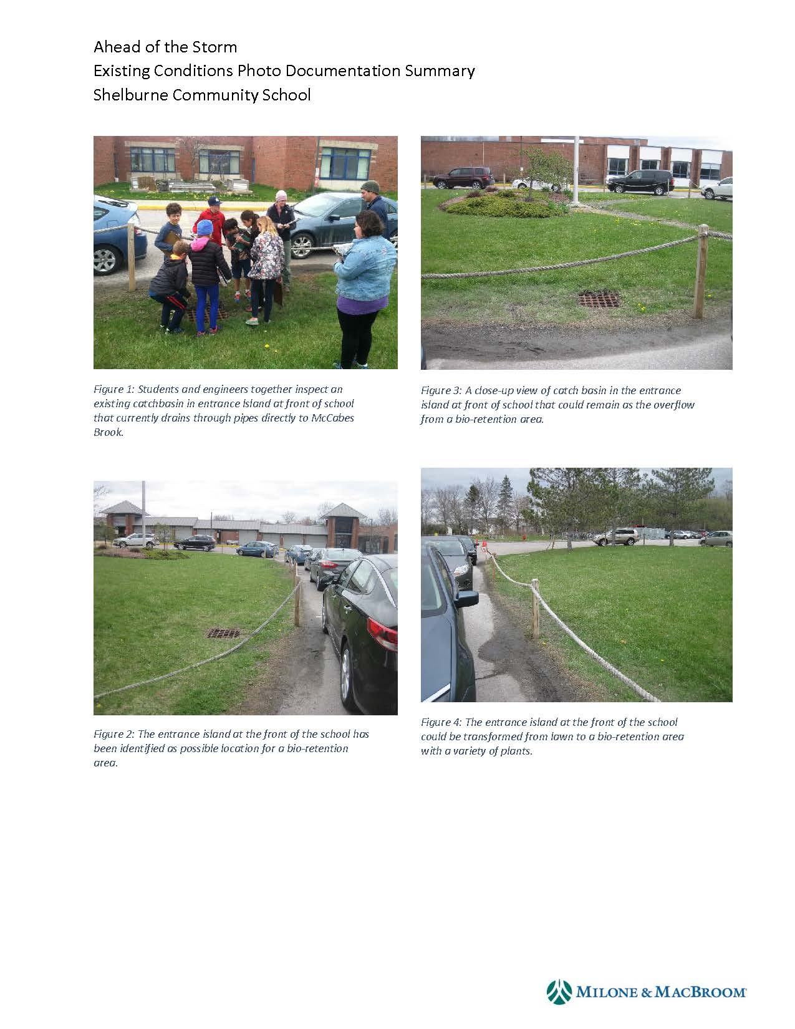
Site Assessment – Summarize Assessment

Slide 26
Design Plans - Watershed Map

Slide 27
Design Plans - Existing Conditions

